Slide 1
Online Learning Platform Using MERN
TEAM BATCH ( ITB22 )
VIJAY SEKAR T G (211521205185)
SATHISH B (211521205140)
VASU R (211521205177)
VAMSEE KRISHNA H (211521205303)

Slide 2
Abstract
Define the problem: Lack of interactivity, scalability, and customization in conventional learning platforms.
Abstract solution: A full-stack web application using MERN.
Key technologies and architecture:
MongoDB: NoSQL database for managing content.
Express.js: Backend framework for routing and handling HTTP requests.
React.js: Frontend library for creating a dynamic and responsive user interface.
Node.js: Server-side environment for handling API requests.
HTML & CSS: For enhancing user experience and visual appeal.
Objectives: Seamless learning, secure content delivery, and user-friendly design.

Slide 3
Introduction
The rise of online education platforms.
Challenges in traditional learning environments.
Importance of a scalable, interactive, and dynamic platform.
Overview of MERN (MongoDB, Express, React, Node) Stack.
Use of additional HTML & CSS for a customized user interface.

Slide 4
Proposed system
Features:
User registration and login.
Course catalog and search functionality.
Video tutorials and document downloads.
Discussion forums and quizzes.
Progress tracking and certifications.
MERN Stack Structure:
MongoDB: Storing user data, courses, progress.
Express.js: API endpoints to fetch courses, user details.
React.js: Frontend to manage UI elements like course pages, quizzes.
Node.js: Backend server to handle API requests and communication with the database.
HTML & CSS: Enhancing the platform’s design, ensuring cross-browser compatibility, and creating a responsive layout.

Slide 5
System Architecture
Front-end (React, HTML, CSS): For user interface components, responsive design, and rendering content dynamically.
Back-end (Node.js, Express.js): For API integration, session management, and user authentication.
Database (MongoDB): Stores user profiles, courses, feedback, progress tracking, etc.
Flow Diagram:
User → React Frontend → Express API → Node.js Server → MongoDB Database.

Slide 6
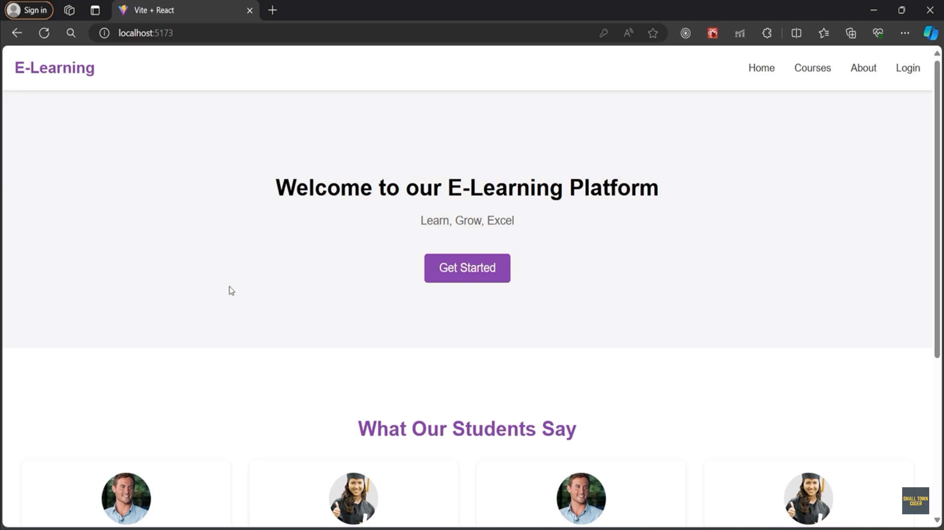
Model Screenshots

Slide 7
CONCLUSION
Summary of the project's aim and its success.
MERN as a modern solution for building scalable, responsive learning platforms.
How HTML and CSS enhanced the user experience.
Future scope: Incorporation of AI for personalized recommendations, gamification for better engagement.
Significance of user-friendly and dynamic online learning platforms in today’s education ecosystem.

Slide 8
THANK YOU

